Slide 1
CSE 2217 Design and Analysis of Algorithms – II Lecture 4 Solving recurrence relation
Tahmid Mosaddeque
Lecturer
Department of CSE, UIU
Notes:
1

Slide 2
Divide and Conquer Algorithms
Example
Binary Search
Merge Sort
Quick Sort
Counting
Closest Pair of Points
2

Slide 3
Divide and Conquer
Divide the problem into a number of subproblems
There must be base case (to stop recursion).
Conquer (solve) each subproblem recursively
Combine (merge) solutions to subproblems into a solution to the original problem
3

Slide 4
Divide-and-Conquer
Most common usage.
Break up problem of size n into two equal parts of size ½n.
Solve two parts recursively.
Combine two solutions into overall solution in linear time.
Consequence.
Brute force: n².
D&C: n logn
4

Slide 5
Mergesort
Mergesort.
Divide array into two halves.
Recursively sort each half.
Merge two halves to make sorted whole.
A
L
G
O
R
I
T
H
M
S
A
L
G
O
R
I
T
H
M
S
divide
O(1)
A
G
L
O
R
H
I
M
S
T
sort
2T(n/2)
A
G
H
I
L
M
O
R
S
T
merge
O(n)
5

Slide 6
Merging
Merging. Combine two pre-sorted lists into a sorted whole.
How to merge efficiently?
Linear number of comparisons.
Use temporary array.
A
G
L
O
R
H
I
M
S
T
A
G
H
I
6

Slide 7
A Useful Recurrence Relation
Def. T(n) = number of comparisons to mergesort an input of size n.
Mergesort recurrence.
Solution. T(n) = O(n log₂ n).
Assorted proofs. We describe several ways to prove this recurrence. Initially we assume n is a power of 2 and replace Ν with 2^{k}.
7

Slide 8
Proof by Recursion Tree
T(n)
n
T(n/2)
T(n/2)
2(n/2)
T(n/4)
T(n/4)
T(n/4)
T(n/4)
4(n/4)
log₂n
. . .
T(n / 2^{k})
2^{k} (n / 2^{k})
. . .
T(2)
T(2)
T(2)
T(2)
T(2)
T(2)
T(2)
T(2)
n/2 (2)
n log₂n
8

Slide 9
Proof by Telescoping
Claim. If T(n) satisfies this recurrence, then T(n) = n log₂ n.
Pf. For n > 1:
assumes n is a power of 2
9

Slide 10
Proof by Induction
Claim. If T(n) satisfies this recurrence, then T(n) = n log₂ n.
Pf. (by induction on n)
Base case: n = 1.
Inductive hypothesis: T(n) = n log₂ n.
Goal: show that T(2n) = 2n log₂ (2n).
assumes n is a power of 2
10

Slide 11
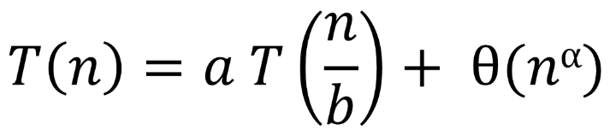
General Formula for D&C
CLRS 4.5 (The Master Method)
problem size = n
Number of divided pieces = a
Size of each piece = n/b
Combine complexity = n^{α}
General form for the recurrence
11

Slide 12
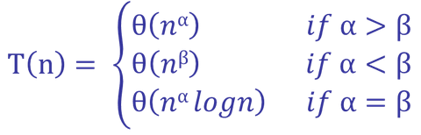
General Formula for D&C
Let β = log_{b}a then the solution
Merge Sort, a = 2, b = 2, β = log₂2 = 1, α = 1.
Θ(n logn)
Binary Search, a = 1, b = 2, β = log₂1 = 0, α = 0.
Θ(logn)
Finding Max, a = 2, b = 2, β = log₂2 = 1, α = 0.
12

Slide 13
Multiplying two n-bit numbers
Naïve approach
Θ(n²)
Divide and conquer approach
Divide each integer into two halves of n/2 bits each
A = A₁2^{n/2} + A₂
B = B₁2^{n/2} + B₂
A x B = (A₁B₁)2^{n} + (A₁B₂ + A₂B₁)2^{n/2} + A₂B₂
So the original problem is divided into 4 sub-problems each with size n/2
Combining requires O(n), since it can be done using addition and bit shift.
13

Slide 14
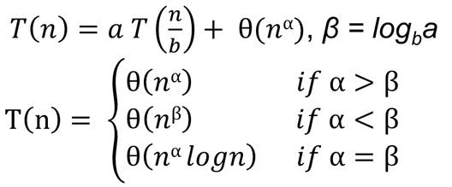
Multiplying two n-bit numbers
14

Slide 15
Multiplying two n-bit numbers Alternate Way
P₁ = A₁B₁
P₂ = A₂B₂
P₃ = (A₁ + A₂)(B₁ + B₂)
A x B = P₁2^{n} + (P₃ – P₁ – P₂)2^{n/2} + P₂
So now we have reduced the number of sub-problems to 3.
As a = 3, b = 2, α = 1, β = log₂3 = 1.59
T(n) = θ(n^{1.59})
15

Slide 16
Read at your own
Strassen’s Amazing Matrix Multiplication Algorithm.
Coremen 4.2
16

Slide 17
!!!Try Yourself!!! – Algorithm to find Second MAX from an array
Derive an Divide & Conquer algorithm to find the Second MAX from an array of N elements and find the complexity of your algorithm.
17

Slide 18
18

Slide 19
!!!Try Yourself !!! - Two Dimensional Search
You are given an m × n matrix of numbers A, sorted in increasing order within rows and within columns. Assume m = O(n). Design an algorithm that finds the location of an arbitrary value x, in the matrix or report that the item is not present. Is your algorithm optimal?
19

